Slide 1
Western Civilization I: Journey Through Ancient Worlds
An Introduction to Prehistory, Egypt, Greece, and Rome 100-Minute 1:1 Tutoring Session

Slide 2
“What Makes a Civilization?”
Opening Question:
Look at this progression of human societies. What do you think are the key elements that transform a group of people into what we call a “civilization”?
Notes:
Image suggestion: Split progression showing hunter-gatherers, early farming settlements, Egyptian pyramids, Greek Parthenon, Roman Colosseum

Slide 3

Before we explore Egypt, Greece, and Rome, we need to understand what came before and what makes these societies distinctive.
Notes:
Keep this slide text-light to encourage discussion

Slide 4
Why Does Ancient History Matter Today?
Modern Connections:
Democratic institutions → Greek innovations
Legal systems → Roman contributions
Monumental architecture → Egyptian engineering
Agricultural foundations → Neolithic revolution
Notes:
Image suggestion: Modern courthouse with Greek columns

Slide 5
The Big Questions We’ll Explore
How do human societies develop complexity and organization?
What different relationships can exist between individuals and governing structures?
How do societies define and pursue what they consider a good life?
How do civilizations influence those that come after them?
Notes:
Keep this focused on just the questions for visual impact

Slide 6
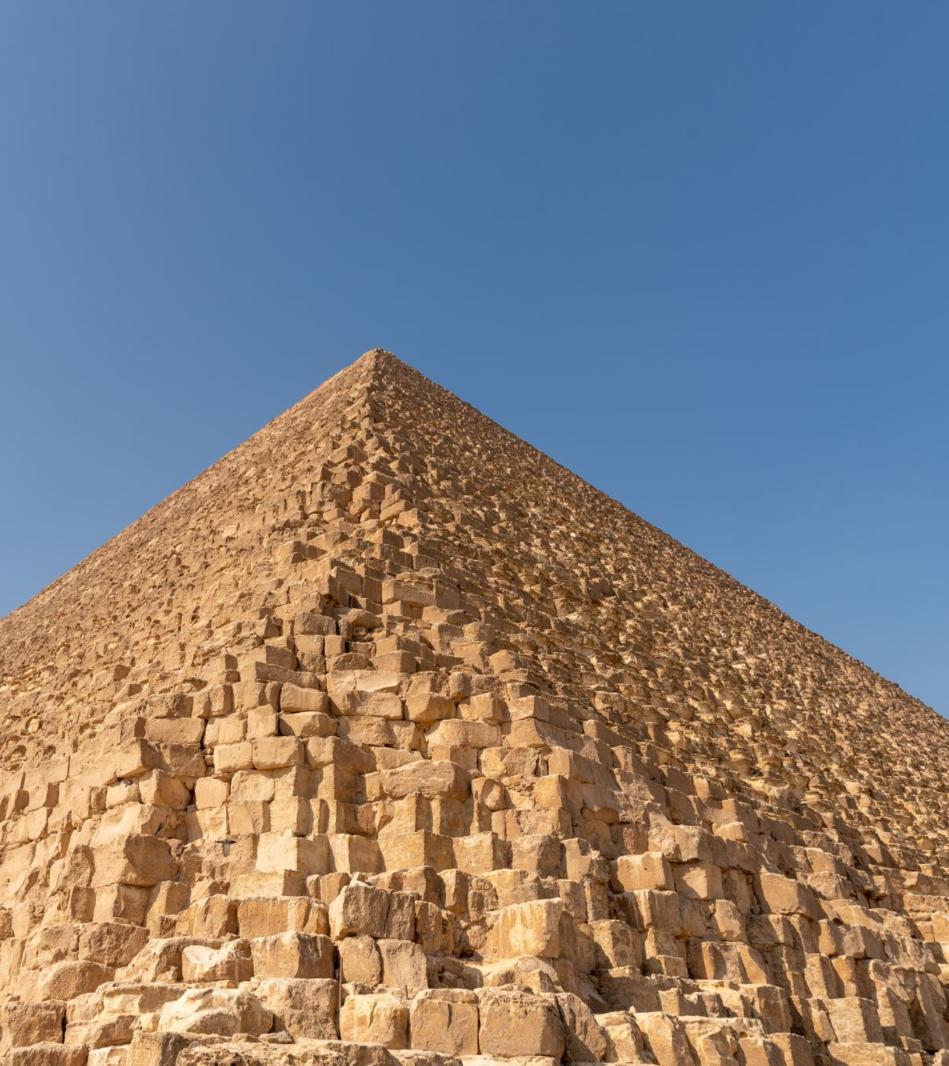
A Four-Part Journey
PREHISTORY & EARLY CIVILIZATION (10,000-3100 BCE)
EGYPT (3100-30 BCE)
GREECE (800-146 BCE)
ROME (753 BCE-476 CE)
Notes:
Image suggestion: Timeline showing progression from 10,000 BCE to 476 CE with visual markers

Slide 7
Prehistory & Early Civilization
The Foundation Period 10,000-3100 BCE
Neolithic Revolution
First cities and states
Development of writing
Foundations of complex society
Notes:
Image suggestion: Cave paintings and early farming

Slide 8
Egypt
River Valley Innovation 3100-30 BCE
Nile River civilization
Divine kingship concepts
Monumental architecture
Hieroglyphic writing system
Notes:
Image suggestion: Pyramids and Nile River

Slide 9
Greece
City-State Experimentation 800-146 BCE
City-state organization
Democratic innovations
Philosophical inquiry
Cultural achievements
Notes:
Image suggestion: Parthenon and Mediterranean map

Slide 10
Rome
Integration and Expansion 753 BCE-476 CE
Republican government
Engineering and law
Imperial expansion
Administrative systems
Notes:
Image suggestion: Roman roads and Colosseum

Slide 11
The Neolithic Revolution
c. 10,000 BCE - The Game Changer
From hunting and gathering to agriculture
How did this transform human society?
Notes:
Image suggestion: Transition from hunting to farming scenes

Slide 12
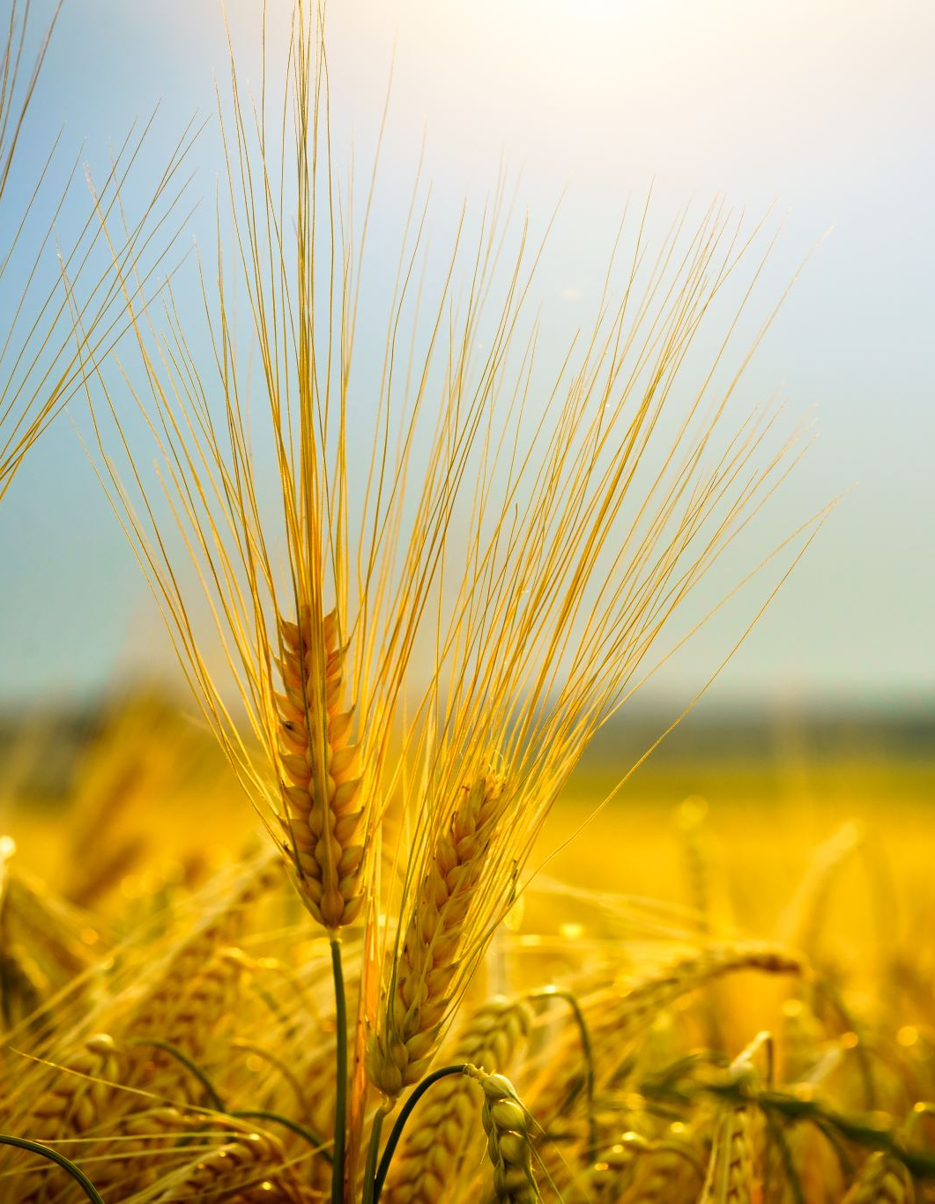
Changes from Agriculture
New Challenges, New Opportunities:
Population growth and permanent settlement
Specialization of labor - different skills and roles
Social stratification - why did some gain more power?
Surplus production - freeing people for other activities
Notes:
Visual showing population growth and settlements

Slide 13
First Civilizations: Mesopotamia
c. 3500 BCE - Writing, Cities, and States
Sumer: City-states and cuneiform writing
Babylon: Hammurabi’s law code
Assyria: Military organization and empire
Notes:
Image suggestion: Cuneiform tablets and ziggurat

Slide 14
Key Questions About Early Civilization
What conditions allowed these first complex societies to emerge?
How did writing systems change human civilization?
Notes:
Keep this simple for discussion focus

Slide 15
What Defines “Civilization”?
Characteristics Historians Look For:
Urban centers - Cities as organizing hubs
Specialized workers - Beyond just farming
Complex institutions - Government, religion, military
Notes:
Image suggestion: Diagram showing interconnected elements

Slide 16
More Characteristics of Civilization
Additional Elements:
Record keeping - Writing systems
Advanced technology - Tools, buildings, transportation
Social hierarchy - Different classes and roles
Notes:
Continue the definition discussion

Slide 17
Critical Thinking About “Civilization”
Questions to Consider:
Are all of these elements necessary?
Could a society be “civilized” without some of them?
How might different societies prioritize these elements differently?
What biases might exist in how we define “civilization”?
Notes:
Encourage questioning of assumptions

Slide 18
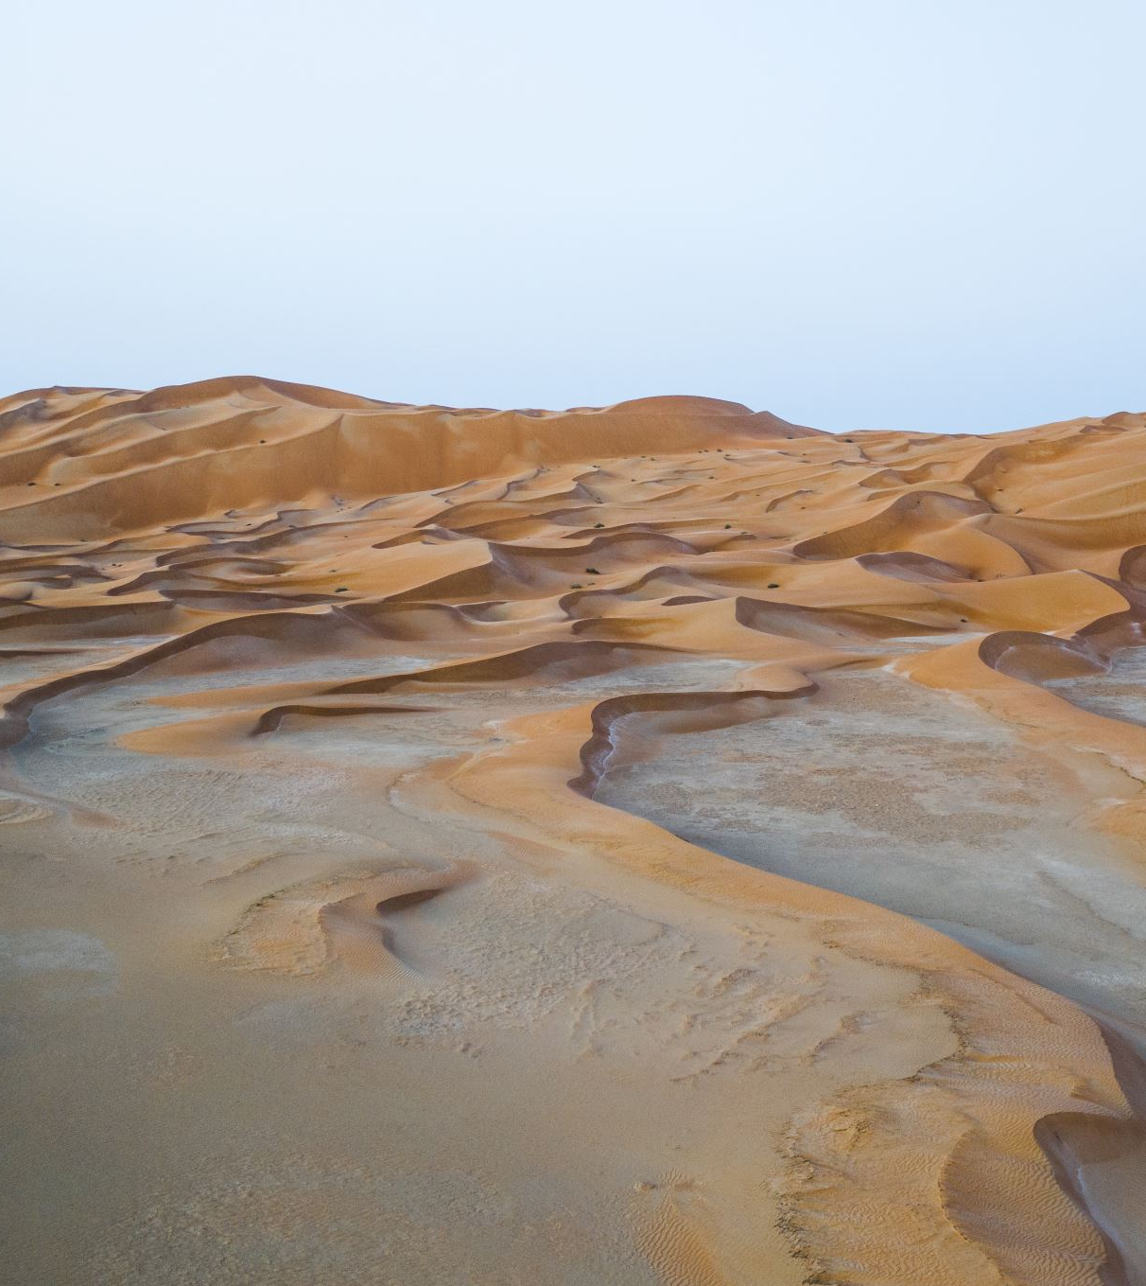
Egypt: Geographic Foundation
The Nile’s Gift:
Predictable flooding - How did this shape Egyptian society?
Natural borders - Desert protection enabling stability
Agricultural surplus - Freeing people for other activities
Notes:
Image suggestion: Nile River satellite view showing green strip through desert

Slide 19
Egyptian Key Themes
What Made Egypt Distinctive:
Pharaonic kingship: Concepts of divine rule
Centralized administration: Managing a large territory
Monumental architecture: Pyramids, temples, and tombs
Cultural continuity: Why did it last so long?
Notes:
Egyptian art and architecture images

Slide 20
Essential Questions: Egypt
How did geography influence Egyptian political and social development?
What are the advantages and disadvantages of highly centralized government?
How do societies balance resources between practical needs and monumental projects?
Notes:
Discussion-focused slide

Slide 21

Greece: Geographic Influence
Mountains and Sea:
Mountainous terrain - Natural boundaries between communities
Maritime access - Trade and cultural exchange
Limited agricultural land - Competition and colonization
Notes:
Image suggestion: Map of Greek city-states and Mediterranean

Slide 22
Greek Key Themes
Innovation in Organization:
Polis system: Independent city-states with different governments
Democratic innovations: Citizen participation in Athens
Philosophical inquiry: Questioning fundamental assumptions
Cultural achievements: Art, literature, and athletics
Notes:
Images of Athens, philosophy, and democracy

Slide 23
Essential Questions: Greece
How can small, independent communities coexist and compete?
What are different ways to organize political participation?
How do societies balance individual excellence with community needs?
Notes:
Keep focused on the big questions

Slide 24
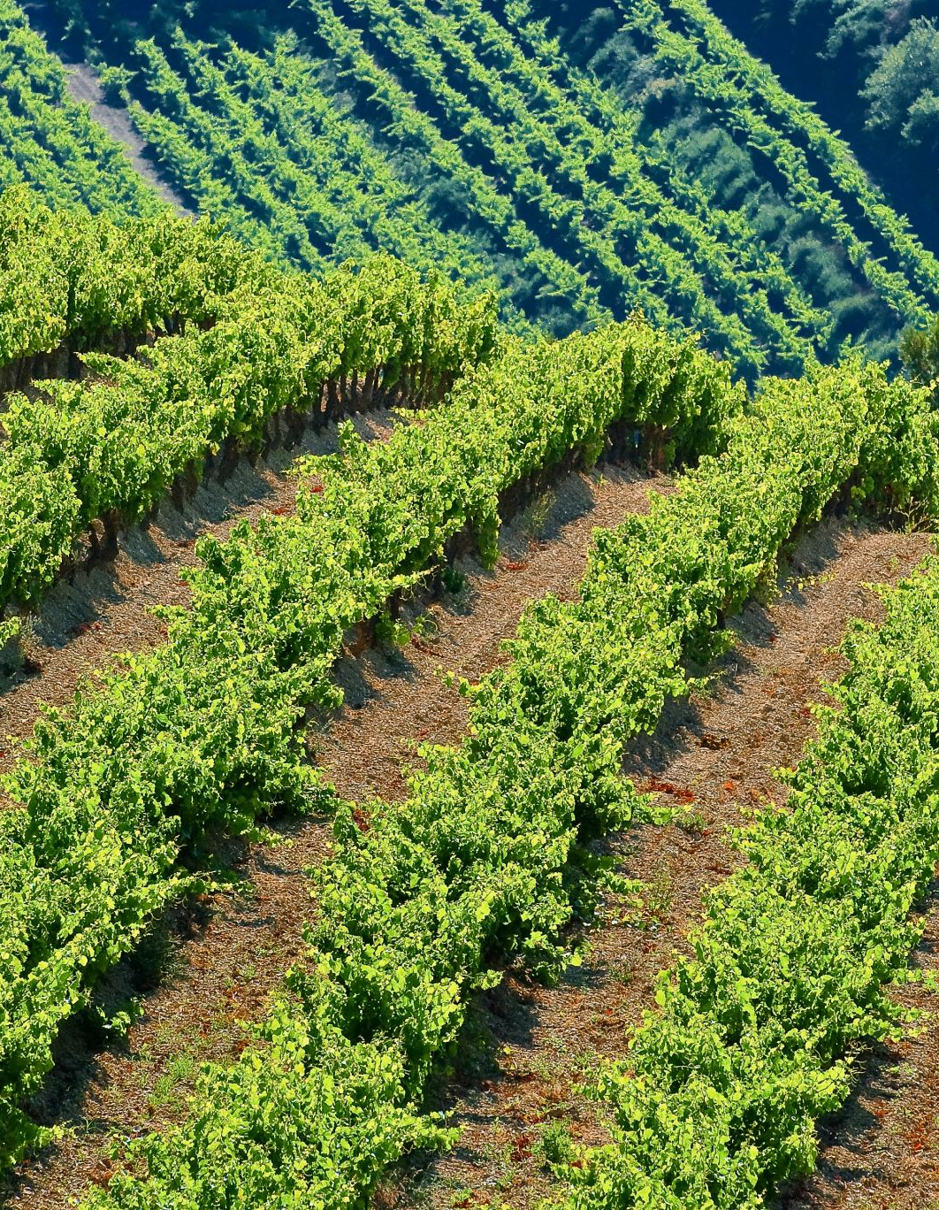
Rome: Geographic Advantages
Central Mediterranean Position:
Strategic location - Access to trade routes
Italian peninsula - Defensible but not isolated
Agricultural potential - Supporting large populations
Notes:
Image suggestion: Roman Empire map showing roads and territories

Slide 25
Roman Key Themes
Masters of Organization:
Republican institutions: Checks, balances, and representation
Military organization: Professional armies and tactics
Legal development: Written laws and legal procedures
Cultural integration: Managing diverse populations
Notes:
Images of Roman engineering, law, and military

Slide 26
Essential Questions: Rome
How do societies govern large, diverse territories?
What institutions help maintain stability during expansion?
How do legal systems develop and adapt to new situations?
Notes:
Discussion-focused

Slide 27
How Societies Build Complexity
Prehistoric Foundations:
Agriculture → Food security and population growth
Settlement → Permanent communities and property concepts
Specialization → Different roles and skills
Notes:
Image suggestion: Flow chart showing progression

Slide 28
Egyptian Contributions to Complexity
Organizational Innovations:
Centralized administration → Bureaucratic organization
Divine kingship → Legitimacy and authority concepts
Record keeping → Administrative continuity
Notes:
Egyptian administrative images

Slide 29
Greek Innovations
New Ways of Thinking:
Citizen participation → Democratic processes
Rational inquiry → Systematic thinking methods
Cultural expression → Artistic and intellectual achievement
Notes:
Images of Athenian democracy and philosophy

Slide 30
Roman Systematization
Practical Solutions:
Legal frameworks → Rules for complex societies
Administrative efficiency → Managing large territories
Cultural integration → Incorporating diverse populations
Notes:
Images of Roman law and engineering

Slide 31
Skills You’ll Master
Critical Analysis Skills:
Source evaluation: What can different types of evidence tell us?
Contextual understanding: How do time and place shape human behavior?
Perspective analysis: How do different groups experience the same events?
Notes:
Image suggestion: Student examining historical evidence

Slide 32
More Skills You’ll Develop
Advanced Historical Thinking:
Cause and consequence: How do we trace connections across time?
Continuity and change: What persists and what transforms?
Notes:
Continue skills discussion

Slide 33
Research and Writing Development
Your Academic Growth:
9th Grade Research Paper: Using primary and secondary sources effectively
Argument construction: Building claims with appropriate evidence
Historical empathy: Understanding past peoples on their own terms
Notes:
Focus on the research paper component

Slide 34
Voices Across Time
Mesopotamian Wisdom (Epic of Gilgamesh):
“The life that you are seeking you will never find. When the gods created man they allotted to him death, but life they retained in their own keeping.”
Notes:
Image suggestion: Ancient texts and tablets

Slide 35
Egyptian Wisdom
Egyptian Instructions (Ptahhotep):
“How good is it for a son to take advice from his father; he will grow old through it.”
Notes:
Egyptian papyrus image

Slide 36
Greek Philosophy
Greek Philosophy (Aristotle):
“Man is by nature a political animal.”
Notes:
Greek inscription or philosopher image

Slide 37
Roman Law
Roman Law (Twelve Tables):
“The law of the Twelve Tables should be learned by heart by every citizen.”
Notes:
Roman legal tablet image

Slide 38
Reflection on Ancient Voices
Key Question:
How do these sources help us understand what each society valued?
Notes:
Discussion slide

Slide 39
What Makes This Course Different
Moving Beyond Memorization:
We’ll analyze actual documents from ancient peoples, look for patterns across societies, and connect to modern relevance.
Notes:
Image suggestion: Comparison of traditional vs. analytical approaches

Slide 40
Primary Source Analysis
Reading Actual Ancient Documents:
Understanding how we know what we know about the past
Recognizing different perspectives and biases
Developing skills in evidence evaluation
Notes:
Examples of primary sources

Slide 41
Comparative Analysis
Looking for Patterns and Differences:
How do different societies solve similar problems?
What factors influence different approaches to governance, religion, and culture?
How do geographic and temporal contexts shape development?
Notes:
Visual showing different societies’ approaches

Slide 42
Modern Connections
Understanding Contemporary Relevance:
How do ancient institutions influence modern ones?
What can past societies teach us about current challenges?
How do we balance learning from history with avoiding oversimplification?
Notes:
Images linking ancient to modern

Slide 43
Your Research Paper Journey
Developing Historical Questions:
Moving from general curiosity to specific, answerable questions
Understanding what kinds of evidence can support different claims
Notes:
Image suggestion: Process diagram from question to paper

Slide 44
Working with Sources
Two Types of Evidence:
Primary sources: Documents, artifacts, and records from the time period
Secondary sources: Modern historians’ interpretations and analyses
Key Skill: Assessing reliability, perspective, and usefulness
Notes:
Examples of primary and secondary sources

Slide 45
Building Arguments
Constructing Historical Arguments:
Crafting clear thesis statements
Supporting claims with appropriate evidence
Addressing counterarguments and alternative interpretations
Notes:
Visual showing argument structure

Slide 46
How Learning Will Be Evaluated
Ongoing Development:
Discussion and analysis during our sessions
Primary source interpretation practice
Writing development through multiple drafts
Research skill building step by step
Notes:
Image suggestion: Portfolio showing progression

Slide 47
Major Demonstrations
Showcasing Your Growth:
Unit assessments combining factual knowledge with analytical thinking
Research paper milestones showing progress toward final project
Comparative analysis across civilizations
Final research paper showcasing developed skills
Notes:
Assessment examples

Slide 48
How Geography Shapes Civilization
River Valleys (Mesopotamia, Egypt):
Predictable flooding and agricultural surplus
Natural boundaries and protection
Trade routes and cultural exchange
Notes:
Image suggestion: Map showing different geographic regions

Slide 49
Geography Continued
Mountainous Regions (Greece):
Isolated communities and political independence
Limited resources and external expansion
Maritime orientation and colonization
Central Locations (Rome):
Access to multiple regions and trade
Opportunities for expansion and integration
Notes:
Mountain and peninsula geography

Slide 50
Key Geographic Question
For Consideration:
How much does environment determine social development, and how much choice do societies have?
Notes:
Discussion-focused slide

Slide 51
Individual and Governing Structures
Three Different Approaches:
Egyptian divine kingship: What happens when rulers claim divine authority?
Greek democracy: How can citizens participate meaningfully in governance?
Roman republic: What institutions help balance different interests?
Notes:
Image suggestion: Different government types

Slide 52
Concepts of Good Life
Three Different Answers:
Egyptian afterlife focus: Preparing for eternity through proper behavior
Greek excellence ideal: Developing human potential through reason and virtue
Roman duty emphasis: Serving community and maintaining order
Notes:
Images representing different life philosophies

Slide 53
Civilizational Development
Big Picture Questions:
How do societies develop complexity and maintain stability?
What causes some civilizations to expand while others remain localized?
How do societies adapt to changing circumstances?
Notes:
Discussion slide

Slide 54
Our Learning Partnership
What We’ll Bring to This Course:
Intellectual Curiosity: We’ll ask challenging questions without simple answers
Historical Empathy: We’ll work to understand past societies within their own contexts
Notes:
Image suggestion: Collaborative learning environment

Slide 55
More Expectations
Our Continued Commitment:
Critical Analysis: We’ll examine evidence carefully and consider multiple interpretations
Respectful Discussion: We’ll engage with difficult topics thoughtfully and maturely
Academic Growth: We’ll see challenges as opportunities to develop stronger thinking skills
Notes:
Continue partnership discussion

Slide 56
Next Session Preview
Session 1: “The Neolithic Revolution”
From hunting to farming - how agriculture changed everything
Notes:
Image suggestion: Timeline of early human development

Slide 57
Coming Sessions
Session 2: “First Cities” - Mesopotamian innovations
Session 3: “The Invention of Writing” - Communication and record-keeping
Session 4: “Early States” - Sumerian and Babylonian organization
Session 5: “Setting the Stage” - Conditions for Egyptian, Greek, and Roman development
Notes:
Preview of upcoming content

Slide 58
Preparation
Begin Thinking About:
What factors allow complex societies to develop and thrive?
Notes:
Assignment slide

Slide 59
Your Questions and Curiosity
Open Discussion:
What aspects of this course are you most interested in exploring?
What questions do you have about how we’ll approach these topics?
Notes:
Image suggestion: Question mark with ancient artifacts

Slide 60
Making Connections
Reflection Questions:
What connections are you already seeing between past and present?
Are there particular themes or civilizations you’re especially curious about?
Notes:
Discussion continuation

Slide 61
Remember
Historical thinking begins with good questions.
Your curiosity will shape our learning journey.
Notes:
Inspirational closing

Slide 62
Welcome to Western Civilization I
Our Goal:
You’ll develop the skills to think historically, analyze evidence, and understand how the ancient world connects to our contemporary society.
Notes:
Image suggestion: Path from ancient to modern times

Slide 63
Your Journey
From the first agricultural communities through the foundations of Western political, legal, and cultural traditions.
Understanding how human societies develop complexity and how past innovations continue to influence our world.
Notes:
Course overview conclusion

Slide 64
Ready to Begin?
Let’s start with the very beginning:
How humans first created the foundations for civilization itself.
The adventure begins now.
Notes:
Final slide - inspirational

